Slide 1

18CSE392T – Machine Learning I
Department of Data Science and Business Systems

Slide 2
Curse of Dimensionality

Slide 3
Curse of Dimensionality
Dimension
Features
Attributes

Slide 4

SCENARIO
Real estate rate prediction

Slide 5
Features
House age
No. of rooms
No. of bed rooms
No. of floors
Type
Location
Cost

Slide 6

Analyze the performance of a Formula One (F1) driver

Slide 7
i) Model_1 consists of only two features say the circuit name and the country name.
ii) Model_2 consists of 4 features say weather and max speed of the car including the above two.
iii) Model_3 consists of 8 features say driver’s experience, number of wins, car condition, and driver’s physical fitness including all the above features.
iv) Model_4 consists of 16 features say driver’s age, latitude, longitude, driver’s height, hair color, car color, the car company, and driver’s marital status including all the above features.
v) Model_5 consists of 32 features.
vi) Model_6 consists of 64 features.
vii) Model_7 consists of 128 features.
viii) Model_8 consists of 256 features.
ix) Model_9 consists of 512 features.
x) Model_10 consists of 1024 features.
Model_4 don’t actually contribute anything towards analyzing the performance of the F1 driver.
For example, the driver’s height, hair color, car color, car company, and the driver’s marital status is giving useless information for the model to learn, hence the model gets confused with all this extra information, and the accuracy starts to go down.
Notes:
The curse of dimensionality was first termed by Richard E. Bellman when considering problems in dynamic programming.

Slide 8
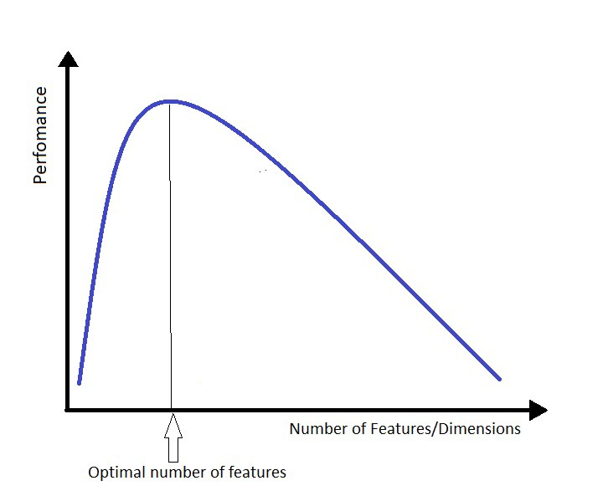
Features
Curse of Dimensionality describes the explosive nature of increasing data dimensions and its resulting exponential increase in computational efforts required for its processing and/or analysis.

Slide 9
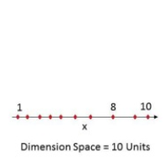
One Dimension
Number of Rooms

Slide 10
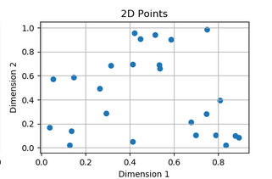
Two Dimension
Number of Rooms vs Costs

Slide 11
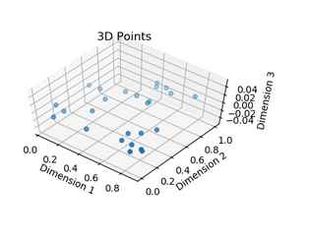
N- Dimension
Number of Rooms
Vs
Number of Floors
Vs
Costs

Slide 12
Definition
The curse of dimensionality refers to the phenomena that occur when classifying, organizing, and analyzing high dimensional data that does not occur in low dimensional spaces, specifically the issue of data sparsity and “closeness” of data.

Slide 13
Cont..
Sparsity of data occurs when moving to higher dimensions.
The volume of the space represented grows so quickly that the data cannot keep up and thus becomes sparse.

Slide 14
Cont..
As the data space seen above moves from one dimension to two dimensions and finally to three dimensions, the given data fills less and less of the data space.
In order to maintain an accurate representation of the space, the data for analysis grows exponentially.
Issues with sorting or classifying the data. In low dimensional spaces, data may seem very similar but the higher the dimension the further these data points may seem to be.
Infinite Features Requires Infinite Training

Slide 15
Drawbacks (Summary)
As the dimension data become more sparse.
Hard to generalize
Need more training data
If the dimension ,every data point is equidistant from all other points.

Slide 16


